Slide 1




Bottle BASH game
Team members:
SUYOG K
ARYA UMESH
PRATHAM R

Slide 2
OVERVIEW
Design
Modules used
Implementation
Team roles and description
Software and Hardware Requirements
Code

Slide 3
Table of Contents
Slide no. | Contents
4 | Design-About Game
5 | Modules Used
6 | Importance of the Game
7 | Implementation
8 9 10 11 | Team Roles PRATHAM-GUI ARYA-Game Mechanics SUYOG-Data Handling
12 | Software and Hardware Requirements
13 | Result and Analysis
16 | Conclusions and Future Enhancements
17 | References

Slide 4
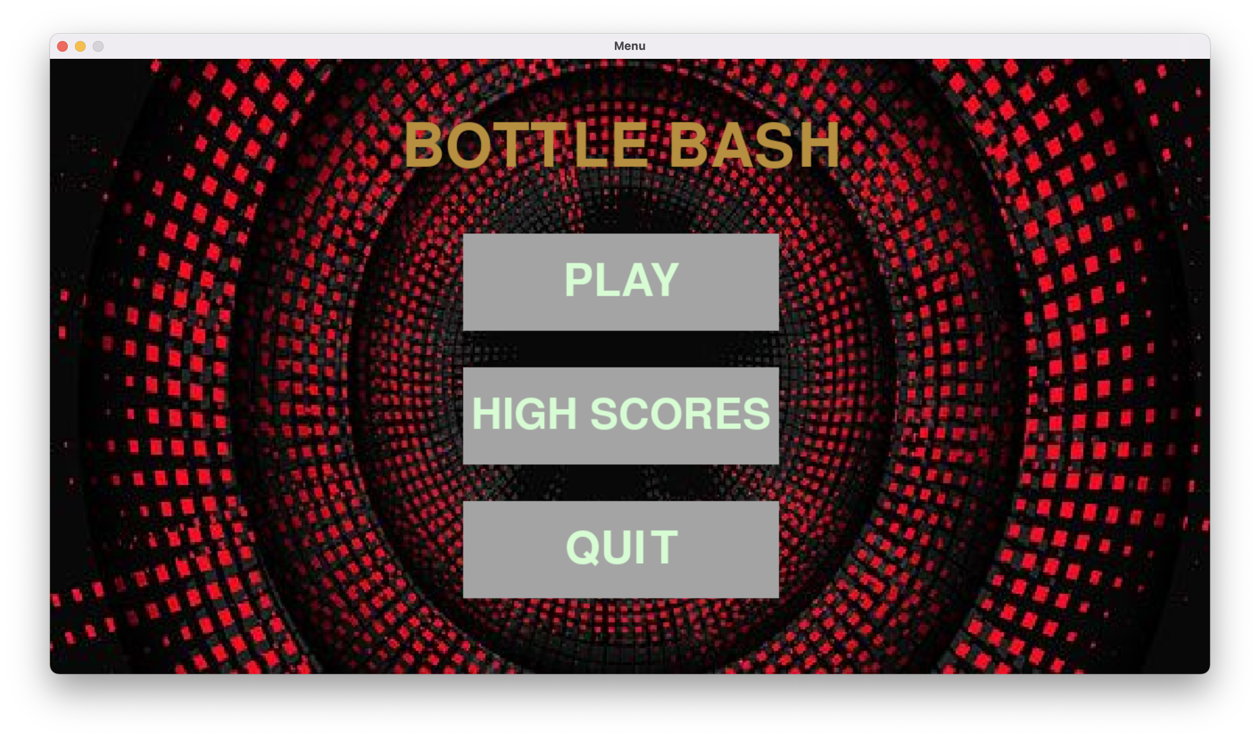
Design-About Game
The agenda of this game is that the player has to click on bottles to break them, there are also hidden bombs which are disguised as bottles, if the player clicks on them he loses a life or entire game(depends on difficulty level chosen).
The game has 3 difficulty levels, namely easy, medium, hard.
The user can enter desired username, difficulty level and also check high score.
The entire program is designed using python language and its modules.
Add interface image here

Slide 5


Modules Used
Pygame: for GUI interface and Game mechanics and user interaction
Sqlite3: for connecting python with Sqlite3 DBMS
Time: used to manipulate time allowed in game
Random: to manipulate bottle and bomb positions and other features
Sys: to take system font

Slide 6
Importance of the Game
Ever since the COVID-19 pandemic and the lockdowns that followed began, the mental heath of many individuals has greatly deteriorated.
Due to being locked up in their homes, social interaction has also taken a hit.
To help make up for it, this game can allow groups of people to compete with one another and in doing so, encourage social interaction.
This friendly competition can help reduce mental stress as it creates a diversion from any college or office related stress and hence, can improve the mental health of the individual.

Slide 7
Implementation
Programming language used: Python 3
The GUI uses Pygame module and game uses Pygame, Random and Time modules, the entire program data is handled using Sqlite3
The program has 3 distinct layers: GUI + Game + DBMS
GUI allows player to choose his name, difficulty level, get instructions and so on
Game layer handles game mechanics
DBMS layer connects python and Sqlite3

Slide 8
Team Roles
Pratham-GUI
Arya-Game Mechanics
Suyog-Data Handling

Slide 9
PRATHAM-GUI
Pygame and sys modules are used to create the opening screen
The functions used are main_menu (to let the player decide if they want to play or check the high scores), SCORES( to let the player check the highest scores in each difficulty level), play (to let the player enter their name) and start (to start playing the game)
Buttons are used to direct the player to either check their scores, play the game or quit the program entirely.

Slide 10
ARYA-Game Mechanics
Pygame, time and random modules are used to make the game
The bottles, lives left and bombs are made using different geometrical objects
The player’s name, current score, number of lives left and time left are displayed on the screen
The functions used are timer (to display the time left), score (to display the player’s current score)
The game (including the above functions) is put in a parent function known as GAME, which takes name and difficulty level as parameters

Slide 11
SUYOG-Data Handling
Sqlite3 module is used to connect python and Sqlite DBMS
The code has several functions, which makes individual connections to prevent conflict
There are 4 functions which: checks for old existing player, enters data into the table, clears tables and checks player high score respectively
The table containing data is created once and for all the first time the program is run in a new computer, the whole process is automated

Slide 12
Software and Hardware requirements
Software :
Python 3
Suitable OS
Suitable IDE or Terminal
Hardware:
A decently fast computer (Dual core processor or better)
Disk space of 10MB
Enough RAM for the computer to have minimum functionality

Slide 13
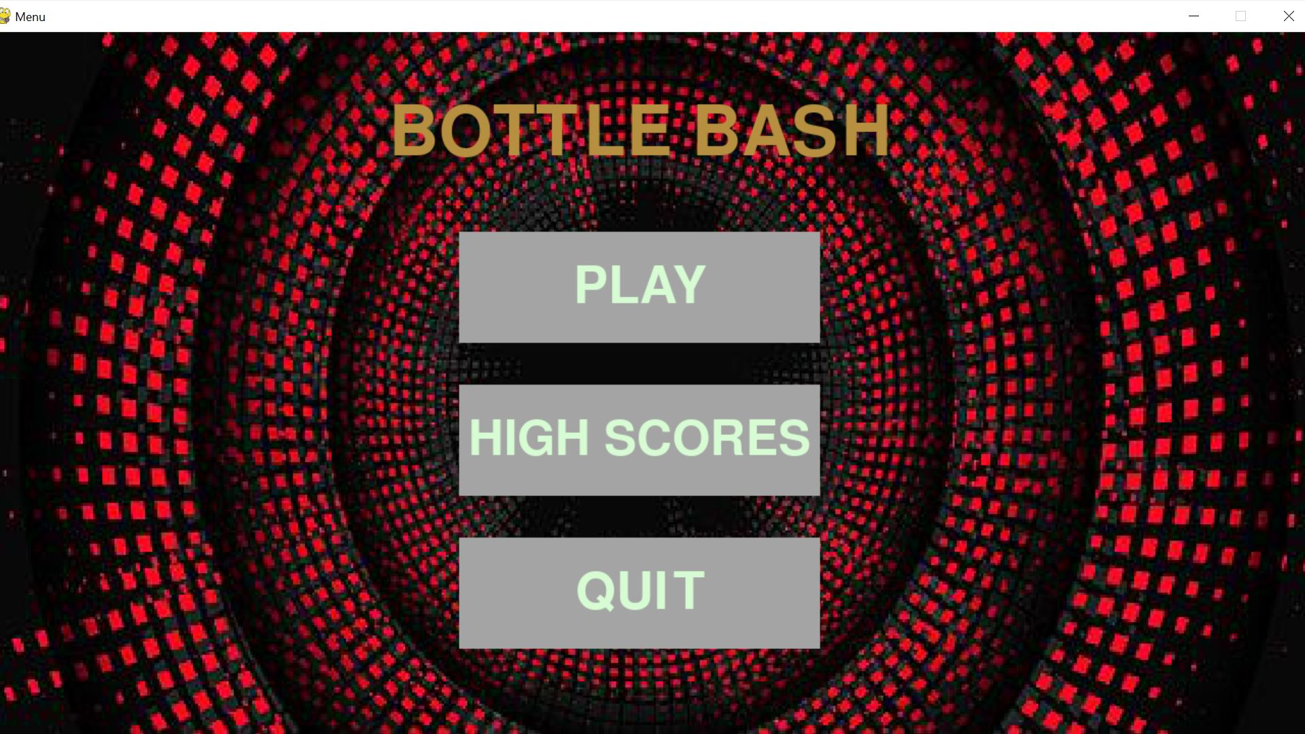
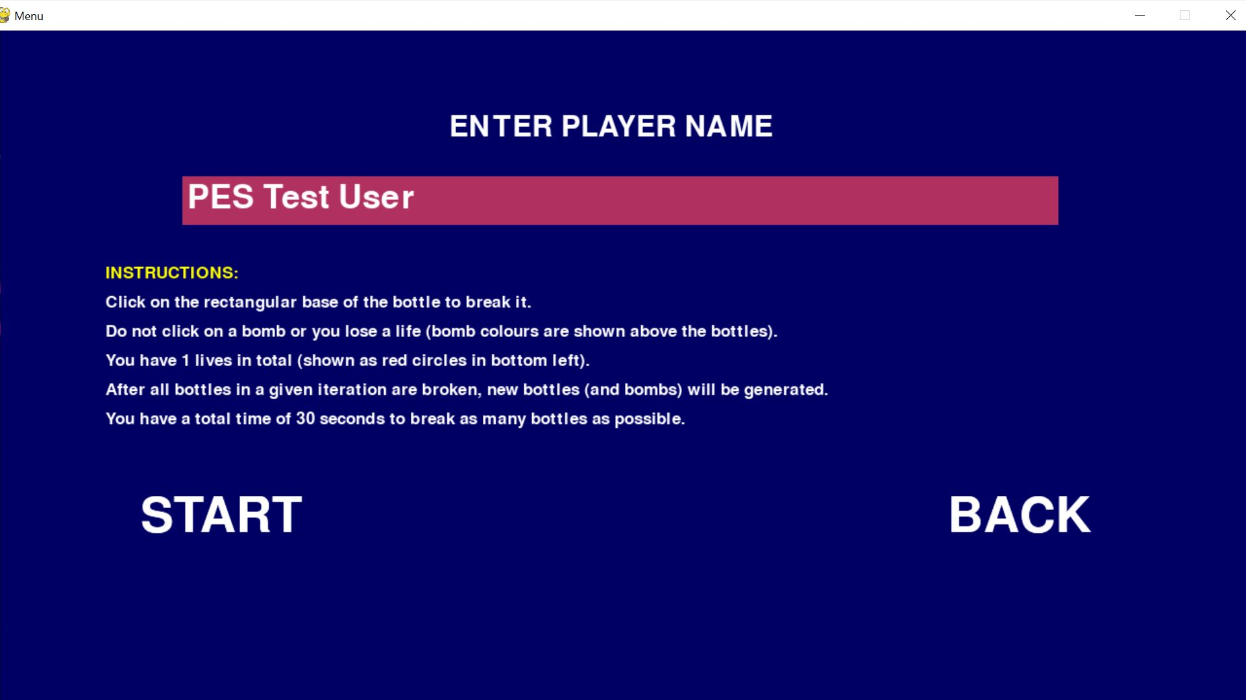
Result and Analysis
Main Menu
Entering Player Details

Slide 14
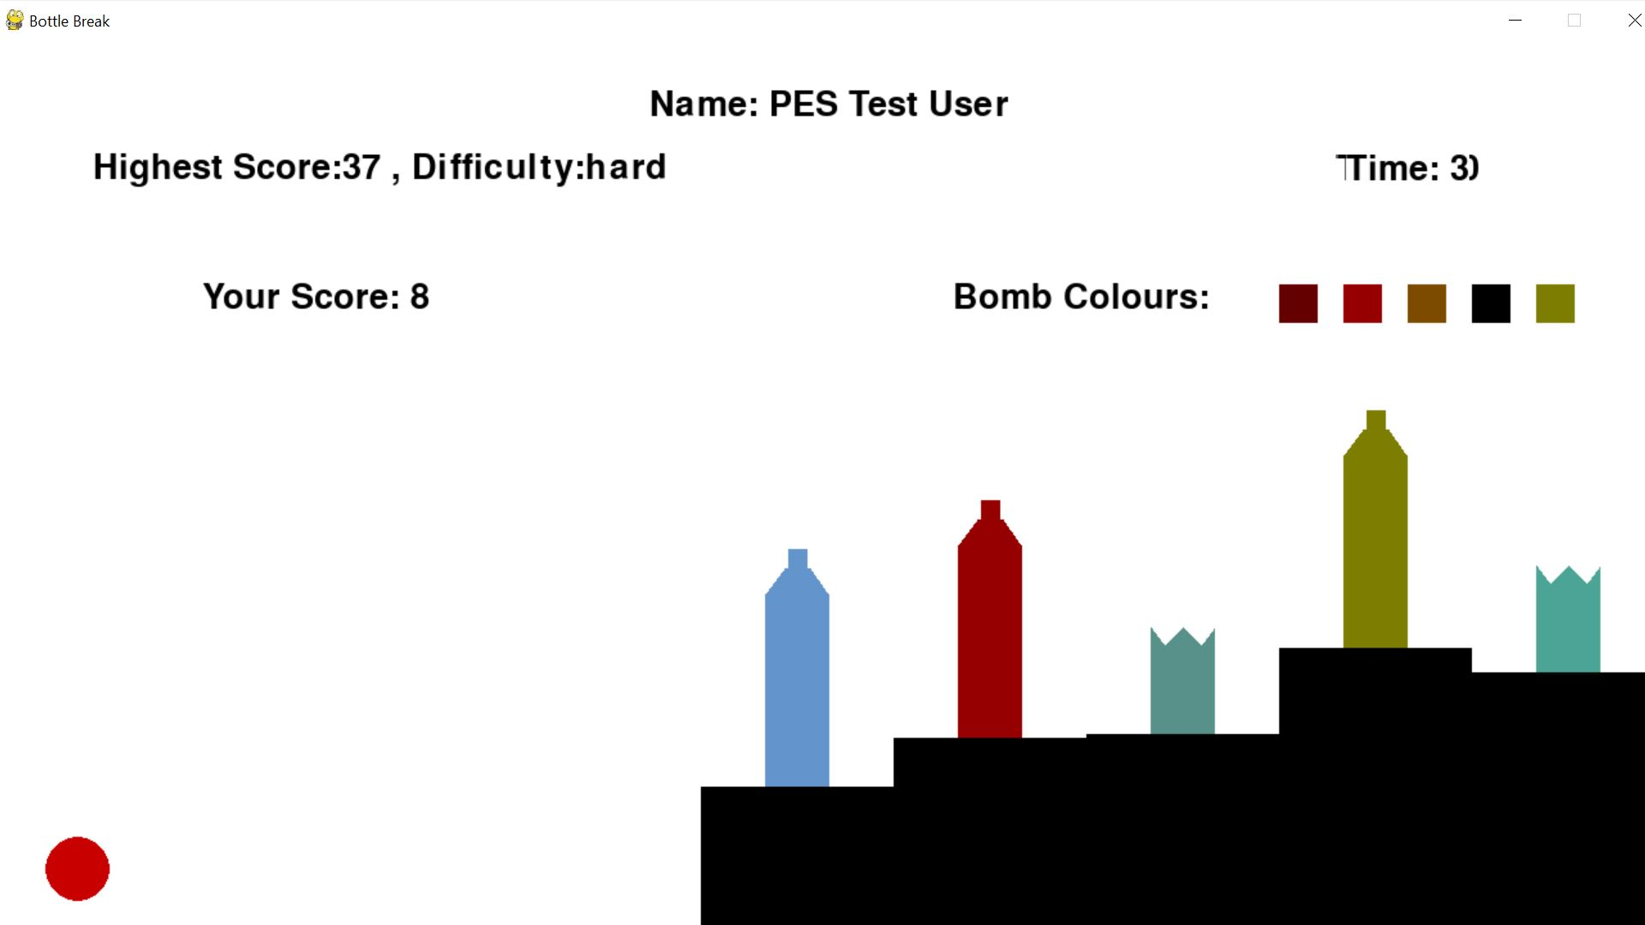
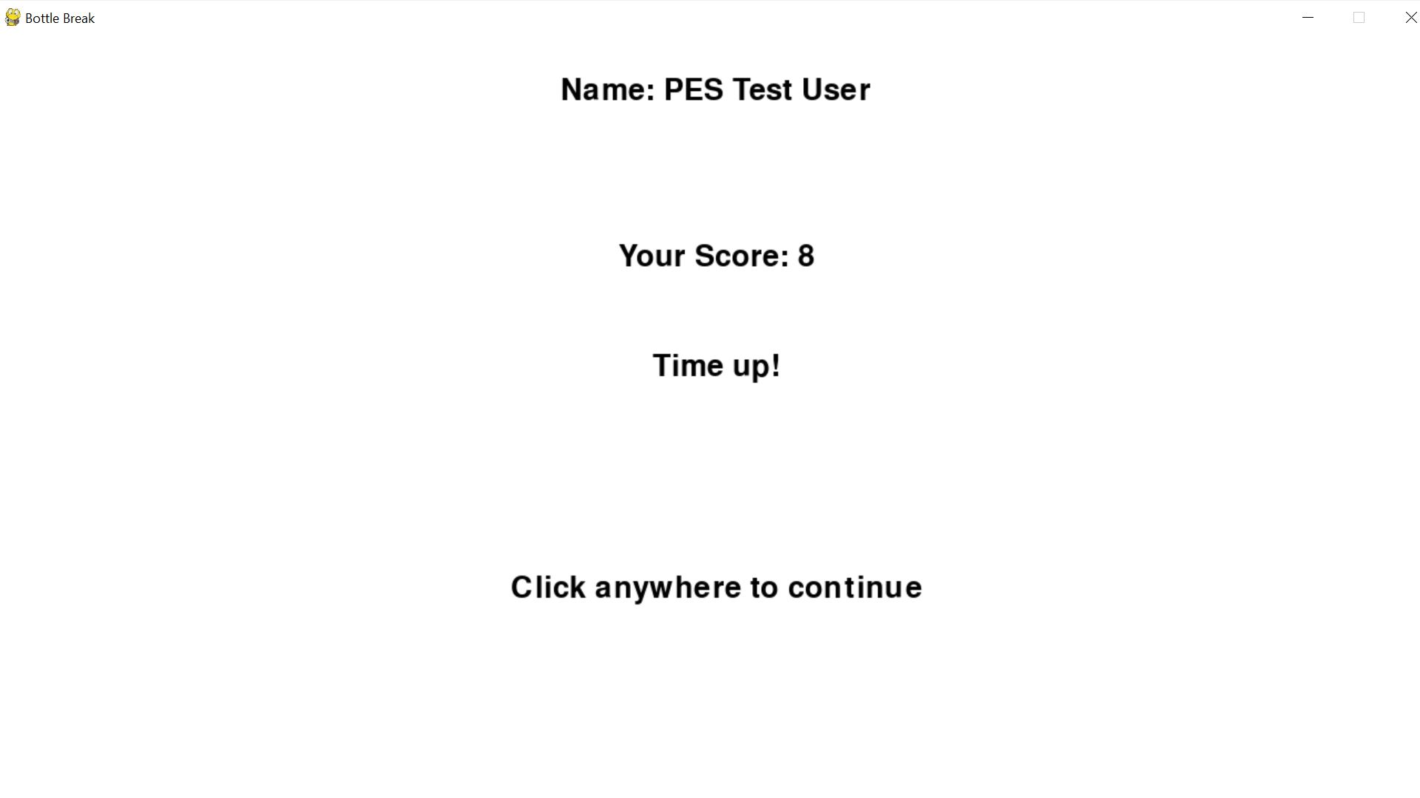
Game Screen (Hard)
Game Over

Slide 15
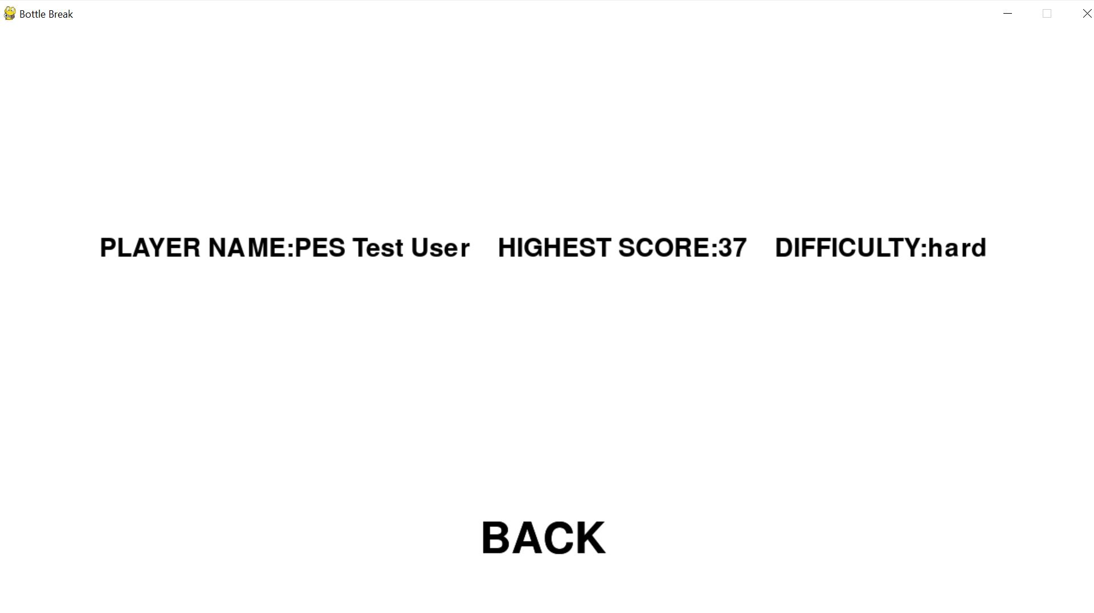
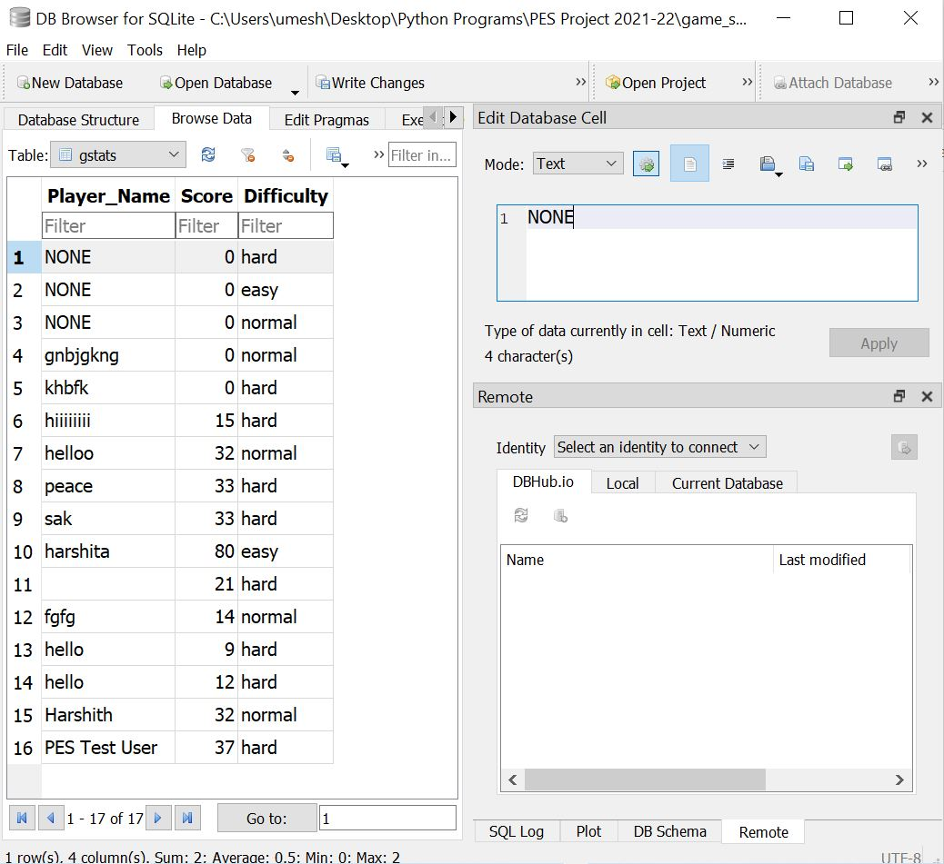
Highest Score (Hard)
Table Containing Names of All Participants

Slide 16
Conclusion and Future Enhancements
This game can be addictive and help reduce mental stress.
In the future, the game can be modified to allow people to hold competitions online, requiring them to deposit some money to participate. Those with the highest scores will be eligible for cashprice and other rewards.

Slide 17
References
https://www.geeksforgeeks.org/introduction-to-pygame/
https://realpython.com/pygame-a-primer/
https://pythonprogramming.net/pygame-drawing-shapes-objects/
https://coderslegacy.com/python/pygame-mouse-click/
https://www.programiz.com/python-programming/time

Slide 18
THANK YOU

